Slide 1
Neurological Assessment in Common Clinical Conditions
Charlotte Price, Highly Specialist Physiotherapist in Neuro Rehabilitation (Guest Lecturer)

Slide 2
Lecture Learning Outcomes:
1. Describe the pathophysiology, progression, and hallmark clinical features of: Multiple Sclerosis (MS), Parkinson’s Disease (PD), Motor Neurone Disease (MND), Cerebellar Ataxia, Hyperkinetic Disorders, Functional Neurological Disorder (FND) and Stroke (CVA)
2. Identify common patterns of motor and sensory deficits associated with each condition.
3. Recognise red flag indicators and situations requiring urgent medical referral.
4. Outline physiotherapy roles and priorities in the assessment and management of these conditions.

Slide 3
Multiple Sclerosis MS

Slide 4
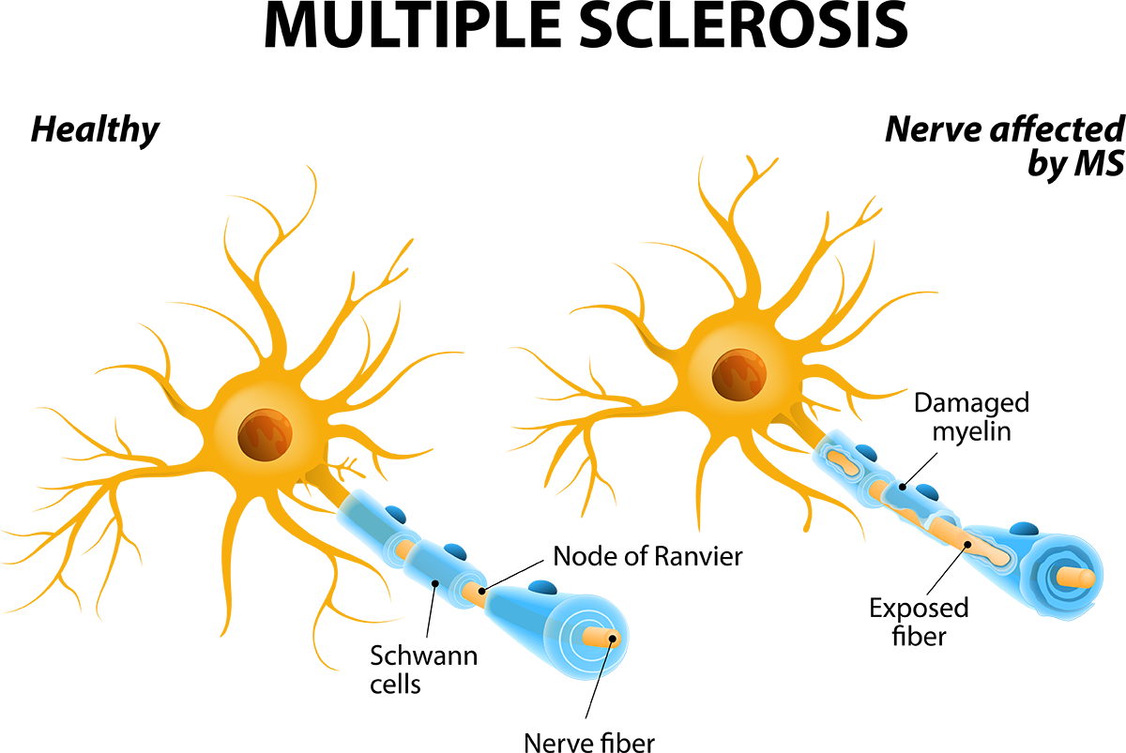
MS
Multiple sclerosis is a chronic autoimmune disease affecting the central nervous system and is characterized by inflammation, demyelination, gliosis, and neuronal loss.
Varied disease courses, including:
Relapsing-remitting, primary progressive, and secondary progressive

Slide 5
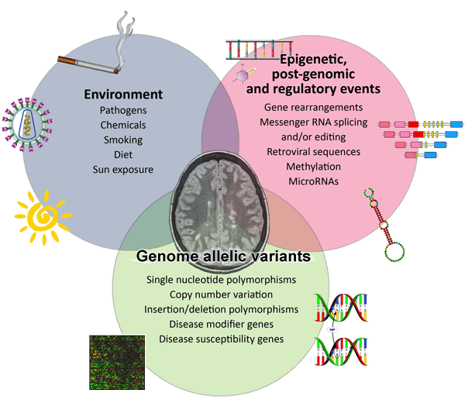
MS Aetiology
Notes:
The exact cause of multiple sclerosis (MS) is unknown, but it is believed to result from a combination of genetic predisposition and environmental factors, including a possible link to certain viral infections like the Epstein-Barr virus. Other risk factors include smoking, low vitamin D levels, and a family history of the disease. MS is an autoimmune disease where the immune system mistakenly attacks the myelin sheath that protects nerve fibers in the brain and spinal cord.

Slide 6
MS Epidemiology
The average age for an MS diagnosis is around 30 years old, with most people being diagnosed between the ages of 20 and 40.
2.9 million people in the world have multiple sclerosis. The UK has more than 150,000 people living with MS.
MS is two to three times more common in women than it is in men
The distribution of MS around the world is uneven. Generally, the prevalence increases as you travel further north or south from the equator. Countries that lie on the equator tend to have extremely low levels of MS, whilst places closer to the Poles such as New Zealand, Canada and Scotland have particularly high rates.
Notes:
Multiple Sclerosis (MS) is more common further from the equator primarily because of lower levels of vitamin D, which is synthesized in the skin from sunlight exposure. People who live closer to the equator receive more year-round sunlight, which leads to higher vitamin D levels. Research suggests that vitamin D plays a role in immune system regulation, and low vitamin D is considered a risk factor for developing MS

Slide 7
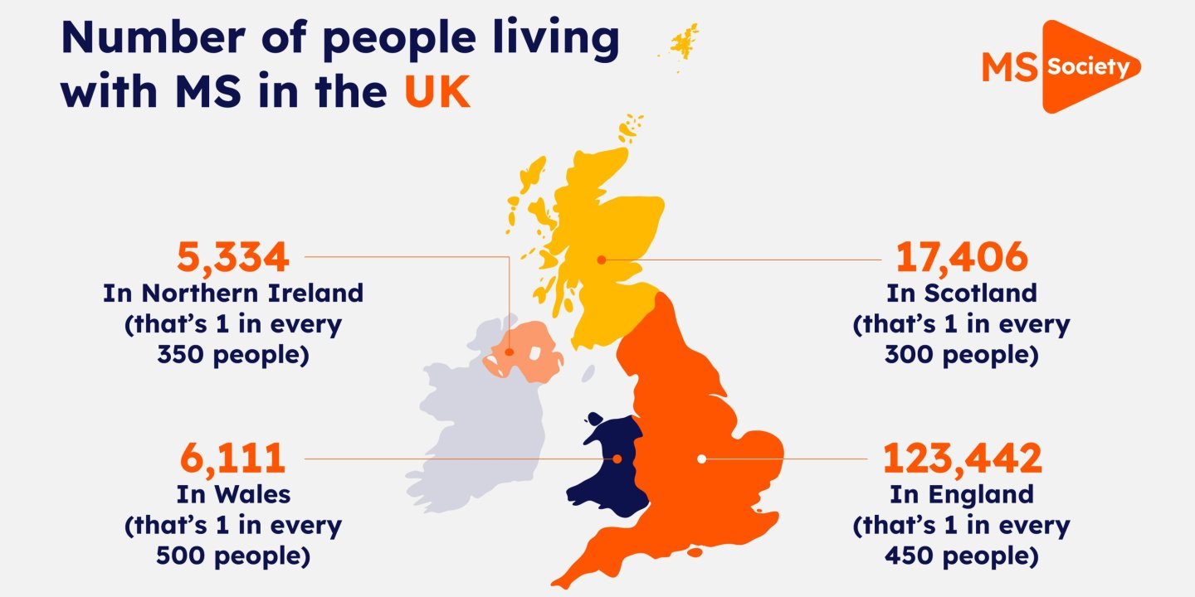
Notes:
We estimate there are over 150,000 people with MS in the UK, and that nearly 7,100 people are newly diagnosed each year.
This means that around one in every 400 people in the UK has MS, and that each week, 135 people are diagnosed with MS.
These estimates were developed using The Health Improvement Network (THIN) Database (A Cegedim Proprietary Database). This work uses data provided by patients and collected by the NHS as part of their care and support.

Slide 8
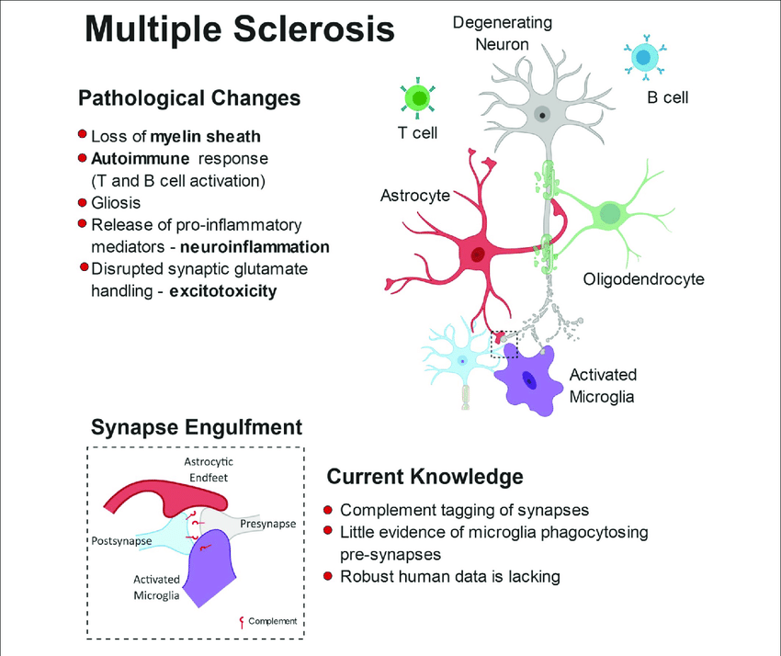
Pathophysiology
• Immune-mediated attack on myelin → inflammation and demyelination.
• T-cells and B-cells cross the blood–brain barrier, triggering immune response.
• Oligodendrocyte damage → impaired nerve conduction.
• Chronic neurodegeneration and axonal loss → disrupted communication in CNS.
Notes:
Gliosis – healing, causes scars and does not help in regeneration
Complement system: The complement system, a part of the immune response, gets activated in MS and marks synapses for elimination. Specifically, complement component C3 localizes to synapses targeted for engulfment.
MS affects both white and grey matter, though it was historically considered a disease of the white matter. The immune system attacks the myelin sheath in white matter, but also damages nerve cell bodies and axons in grey matter, leading to both physical and cognitive symptoms.

Slide 9
Types and Progression
Relapsing–Remitting (RRMS): Most common (≈85%), episodes of symptoms with recovery.
Secondary Progressive (SPMS): Initially RRMS, then gradual worsening.
Primary Progressive (PPMS): Gradual decline from onset.
Clinically isolated syndrome (CIS): Single episode of neurological symptoms that are similar to those of MS. Can have future attack – diagnosed with RRMS

Slide 10
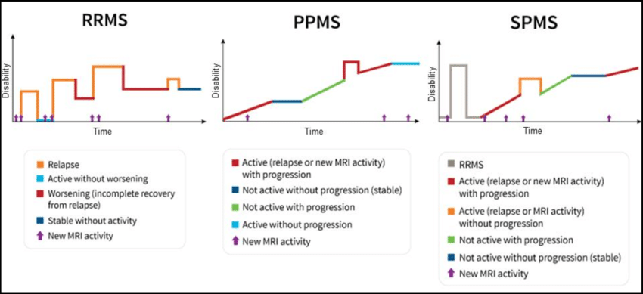
MS Types Disease Course
Notes:
doctors and researchers might use other words to describe it. They may say that MS is one of the following: active, not active, with progression, without progression.
ClassificationDescriptionActive, with progressionNew relapses or MRI activity and gradual worsening disability (e.g. SPMS).Active, without progressionRelapsing disease with no lasting disability increase (e.g. RRMS in remission).Not active, with progressionNo new inflammation, but ongoing gradual decline (e.g. later SPMS).Not active, without progressionStable disease; no relapses or worsening — may represent well-controlled or “burned out” MS.

Slide 11
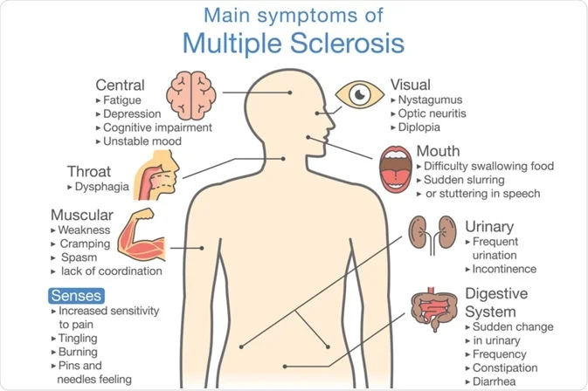
Hallmark Clinical Features
• Motor: weakness, spasticity, tremor, ataxia.
• Sensory: numbness, tingling, neuropathic pain.
• Visual: optic neuritis (blurred/loss of vision).
• Balance and coordination: unsteady gait, dizziness.
• Fatigue: most common disabling symptom.
• Cognitive and autonomic symptoms may also occur.
Notes:
Corticospinal tract → Weakness, spasticity, hyperreflexia.
Cerebellum → Ataxia, tremor, dysarthria, nystagmus.
Dorsal columns → Loss of vibration and position sense.
Optic nerve → Vision loss, eye pain.
Brainstem → Diplopia, dysphagia.
Spinal cord → Lhermitte’s sign (electric-shock sensation).

Slide 12

Red Flags & Urgent Referral Indicators
• Sudden vision loss or severe eye pain.
• Rapidly progressive weakness or paralysis.
• New or severe balance/swallowing problems.
• Unexplained new neurological symptoms.
• Suspected relapse lasting >24 hours.
Change in bladder or bowel function
• Mental health crisis or suicidal ideation.

Slide 13
Physiotherapy Assessment
Priorities:
• Assess motor control, sensation, tone, balance, fatigue, and mobility.
• Use tools: Berg Balance Scale, 6-Min Walk Test, Fatigue Impact Scale.
• Evaluate ADLs and participation (ICF framework).
• Monitor relapse vs remission stage.

Slide 14
Physiotherapy Management
• Strength, balance, and gait re-education.
• Spasticity management: stretching, positioning, splinting.
• Fatigue management: pacing, energy conservation.
• Functional rehab and self-management education.
• MDT collaboration: OT, MS nurse, neurologist, Social service teams, charities
Notes:
PHYSIOTHERAPY MANAGEMENT
Specific Aims:
1. Preserve, maintain and increase muscle strength
2. Promote postural stability
3. Prevent contractures
4. Maintain and encourage weight-bearing
5. Provide support to aid with motivation and continuation of
physiotherapy
6. Provide support to help maintain or increase activity levels
7. Patient education
8. Manage Fatigue
9. Provide aids necessary for living

Slide 15
Early Stage
Mid Stage
Late Stage
Goals: Maintain fitness, promote self-management
Focus: Aerobic & resistance exercise, balance training, fatigue management, education
Outcome: Preserve function and delay progression
Goals: Maximise independence, manage spasticity/fatigue
Focus: Gait training, fall prevention, stretching, assistive devices, endurance work
Outcome: Maintain mobility & prevent complications
Goals: Maintain comfort, prevent complications, optimise quality of life
Focus: Positioning, passive movement, respiratory care, equipment, carer training
Outcome: Support comfort, participation & dignity

Slide 16
Evidence-Based Interventions
• Exercise therapy improves strength, mobility, and fatigue.
• Aerobic and resistance training safe in stable MS.
• Balance and coordination training reduces fall risk.
• Hydrotherapy helps fatigue and spasticity.
Fatigue and exacerbating factors need to be considered when assessing, treating and managing these patients e.g. weather, activity levels

Slide 17
MS references
Khan, G., Hashim, M.J. Epidemiology of Multiple Sclerosis: Global, Regional, National and Sub-National-Level Estimates and Future Projections. J Epidemiol Glob Health 15, 21 (2025). https://doi.org/10.1007/s44197-025-00353-6
Meeting Physical Activity Guidelines for Persons With Multiple Sclerosis Reduces Fatigue Severity and Impact: A Systematic Review and Meta-Analysis of Randomized Clinical Trials.” Physical Therapy. 2025;105(6).
Amatya B., Khan F., La Rocca N. “Effectiveness of Physiotherapy Interventions on Spasticity in People With Multiple Sclerosis: A Systematic Review and Meta-Analysis.” Multiple Sclerosis and Related Disorders. 2018;24:36-44.
Gunn H., Cattaneo D., Hammond A. et al. “The Effectiveness of Physiotherapy Interventions for Mobility in Severe Multiple Sclerosis: A Systematic Review and Meta-Analysis.” Multiple Sclerosis International. 2022;2022:189255.
Langer-Gould A., Jenkins T.M., Schulz K.H. “Functional Exercise Training in Persons With Multiple Sclerosis: A Systematic Review.” Journal of Neurology. 2025;272:590.
Here for everyone with MS | MS Society
Home | MS-UK | Supporting your multiple sclerosis journey

Slide 18
Motor Neurone Disease

Slide 19
MND
MND is a progressive neurodegenerative disorder affecting motor neurons.
Causes muscle weakness, atrophy, and loss of voluntary movement.
Sensory and autonomic systems usually preserved.
Main types:
1. Amyotrophic Lateral Sclerosis (ALS)
2. Progressive Bulbar Palsy (PBP)
3. Progressive Muscular Atrophy (PMA)
4. Primary Lateral Sclerosis (PLS)
Notes:
amyotrophic lateral sclerosis (ALS), degeneration of both the upper and lower motor neurones occurs, leading to paralysis of most voluntary muscles in the body (especially limbs).
When only the muscles involved in speech and swallowing are affected, this is known as progressive bulbar palsy, causing slurred speech and difficulty swallowing
In less common forms of MND, there is a more selective degeneration of either the upper motor neurones (primary lateral sclerosis; PLS) or lower motor neurones (such as progressive muscular atrophy; PMA)

Slide 20
MND Aetiology and Epidemiology
The cause of MND is still not fully understood.
The majority of cases are thought to be caused by a number of contributory factors, including subtle genetic, environmental and lifestyle influences. It is important to note that these factors must all coincide to trigger the disease.
More common in men and typically onset occurs between ages 55 and 75.
Female to Male ratio: 1.5:1 to 2:1.
In approximately 5-10% of cases, MND is directly caused by a genetic mistake – this is inherited.
A number of genes have been identified that can cause inherited MND, including SOD1, TDP-43, FUS, UNC13A, C9ORF72, MATR3, NEK1 and ANXA11.

Slide 21
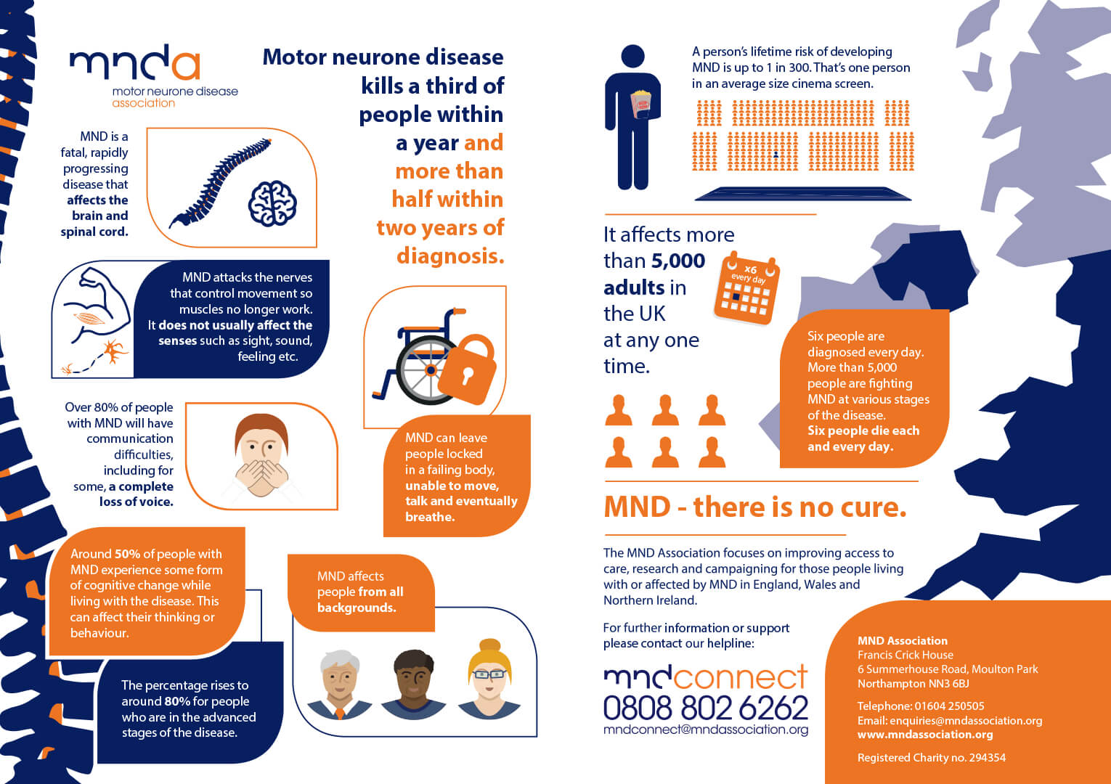

Slide 22
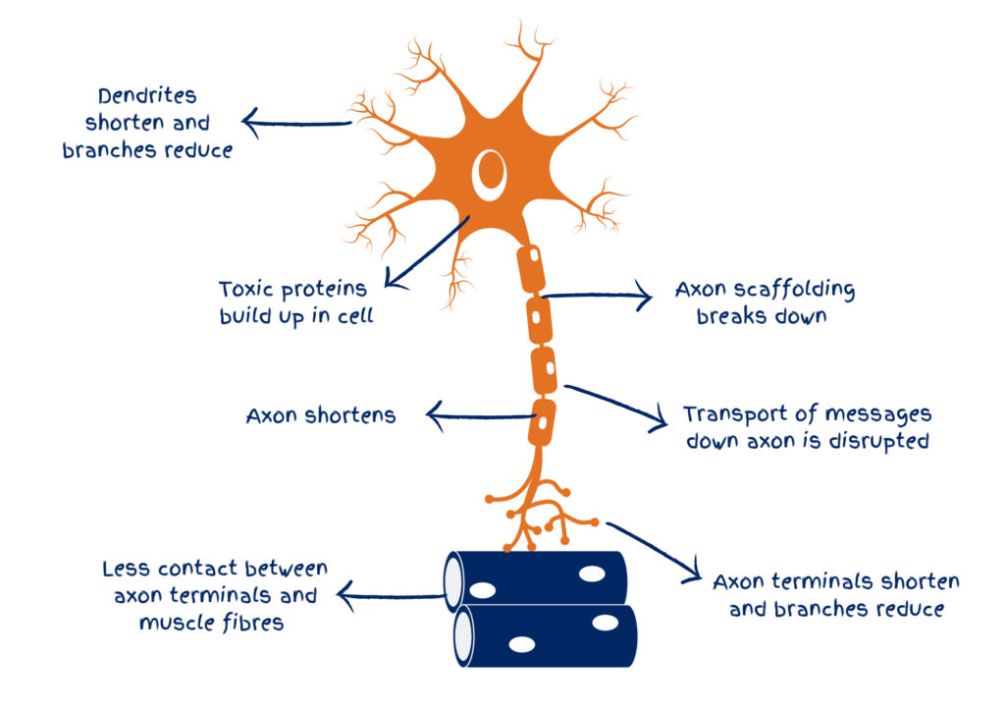
Pathophysiology
Degeneration of upper and lower motor neurons.
• Loss of motor neuron input → muscle denervation and atrophy.
• Mechanisms: glutamate excitotoxicity, oxidative stress, protein misfolding (TDP-43, SOD1). Axonal transport defects.
Notes:
Mechanisms involved:
Glutamate excitotoxicity → neuronal overactivation and cell death
Oxidative stress and mitochondrial dysfunction → energy failure in motor neurons
Protein misfolding and aggregation (e.g., TDP-43, SOD1) → toxic cellular accumulation
Axonal transport defects → impaired nutrient and signal transmission
Neuroinflammation → microglial activation and further neuronal injury
Result: irreversible motor neuron loss → progressive weakness, fasciculations, and paralysis

Slide 23
Disease Progression
Onset is focal (e.g. limb or bulbar) and spreads regionally.
Progressive weakness → respiratory involvement → death (2–5 years average).
Up to half of the people living with MND may also experience difficulties with learning, language and concentration. 30–50% show frontotemporal cognitive involvement – Diagnosed with frontotemporal dementia (FTD)
Stages:
1. Focal weakness
2. Functional limitation
3. Widespread weakness
4. Loss of independence
5. Respiratory failure

Slide 24
Clinical Features
Upper Motor Neuron Signs:
Spasticity, hyperreflexia, Babinski sign (Corticospinal tract degeneration)
Lower Motor Neuron Signs:
Muscle wasting, fasciculations, weakness, hyporeflexia. (Anterior horn cell loss)
Bulbar signs:
Dysarthria, dysphagia, pseudobulbar affect (Brainstem motor nuclei involvement)
Notes:
Fasciculations: These twitches are a result of the lower motor neurons not receiving signals from the upper motor neurons - when a single peripheral nerve that controls a muscle is overactive, resulting in involuntary muscle movement. motor neurons become electrically unstable and fire spontaneously, causing small groups of muscle fibers to contract involuntarily. This happens due to the damage and degeneration of motor neurons, which disrupts the normal signals sent to muscles, eventually leading to a loss of muscle control and weakness.
Pseudobulbar affect (PBA) is a neurological condition that causes outbursts of uncontrolled or inappropriate laughing or crying. These episodes don't match your internal emotional state. PBA develops as the result of a brain injury or underlying neurological condition, such as amyotrophic lateral sclerosis (ALS).

Slide 25
Motor & Sensory Deficits
Motor:
Progressive asymmetric weakness (distal→proximal).
Fasciculations, cramps, loss of dexterity.
Sensory:
Typically spared. Sensory loss → red flag for alternative diagnosis.
The Love Inside: Mike and Zoe - YouTube
Notes:
Progressive asymmetric weakness in Motor Neurone Disease (MND) occurs because the disease's degeneration of motor neurons starts in specific, scattered areas and spreads unevenly. The initial symptoms are often distal (e.g., in the hands, feet, or lower legs) because these muscles are the farthest from the body's center, and thus the degeneration has to advance further down the motor neuron pathways to reach them first.

Slide 26
Red Flag/Urgent referral Indicators
Rapid progression of weakness/dysphagia.
Respiratory symptoms (dyspnoea, orthopnoea)
Unexplained falls, weight loss.
Deterioration in mobility, transfers
New Neck Weakness
Sensory loss, visual symptoms, or sphincter disturbance.
Sudden deterioration or aspiration risk.

Slide 27
Physiotherapy Assessment
Assessment should focus on:
Functional ability, strength, tone, respiration.
Identify issues with fatigue, pain, posture, and mobility.
Equipment and environmental needs.
Outcome Measures:
ALS Functional Rating Scale (ALSFRS-R)
Manual Muscle Testing
Respiratory capacity (VC, MIP, MEP)

Slide 28
Early Stage
Mid Stage
Late Stage
Maintain function, mobility, and endurance.
Gentle strengthening and stretching.
Energy conservation and pacing.
Postural education and joint protection.
• Introduce assistive devices and adaptive equipment.
• Positioning, stretching, and contracture prevention.
• Respiratory care (breath stacking, cough assist).
• Support and education for patients and caregivers.
Passive movements and relaxation.
Comfort, pressure relief, breathing support.
Caregiver training for safe handling.
Liaise with MDT and palliative care.

Slide 29
Physiotherapy Role in MDT
Ensure collaboration with teams including:
Neurologist, OT, SLT, Respiratory Therapist, Dietitian, Palliative Care.
Overall Physiotherapy Aims:
Optimize function, comfort, and quality of life.
Prevent complications.
Support patient and family.
Monitor patients (not discharged from services)

Slide 30
References
• NICE Guidelines: Motor Neurone Disease –(2024)
• Turner MR et al., Lancet Neurology, 2013.
• Talbot K, Brain, 2014.
• RCPhysiotherapy: Guidelines for Physiotherapy in Progressive Neurological Conditions (2022).
Harris, E. & Rowe, A. (2011). *Motor neurone disease: assessment and management.* BMJ 342:d254 — review of presentation, diagnosis, and symptom management. ([PMC][1])
MND Association. (2023). *Physiotherapy and MND: Information Sheet 6A.* Provides physiotherapy-specific guidance. ([MND Association][3])
van der Burgh, H., et al. (2022). “The Global Burden of Motor Neuron Disease.” *Frontiers in Neurology*, 13:864339. ([Frontiers][4])
Sant’Anna, R., et al. (2023). “Update on recent advances in amyotrophic lateral sclerosis.” *Journal of Neurology* (Springer). ([SpringerLink][5])
Zech, M., et al. (2023). “Physical therapy and exercise for MND.” *Hexi / Oxford (online resource).* ([hexi.ox.ac.uk][6])

Slide 31
Parkinson's Disease

Slide 32
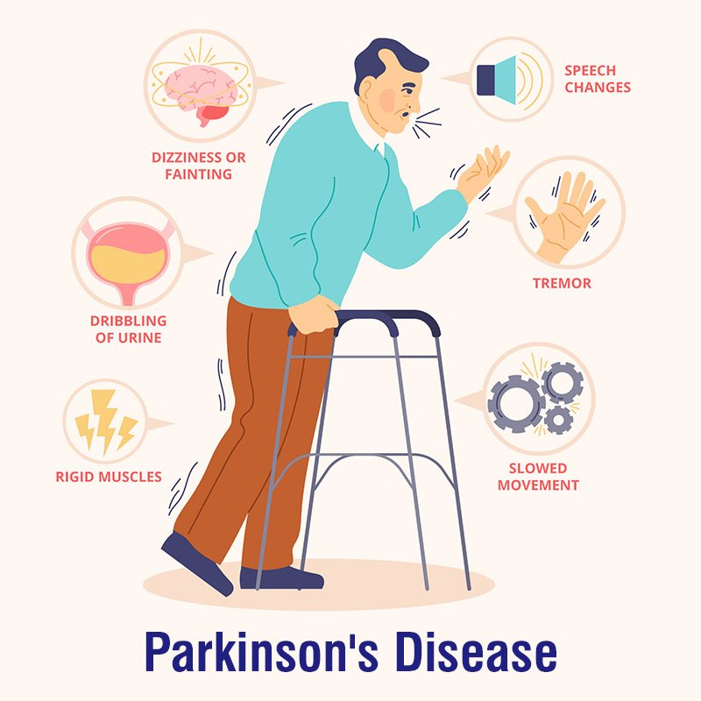
Parkinson’s Disease
A Chronic, progressive neurodegenerative disorder of the basal ganglia.
Characterised by bradykinesia, rigidity, tremor, and postural instability.
There are three main forms of parkinsonism:
Idiopathic Parkinson’s
Vascular parkinsonism
Drug-induced parkinsonism
Notes:
• Usually idiopathic; mean onset around 60 years.
• Affects ~1% of adults >60.

Slide 33
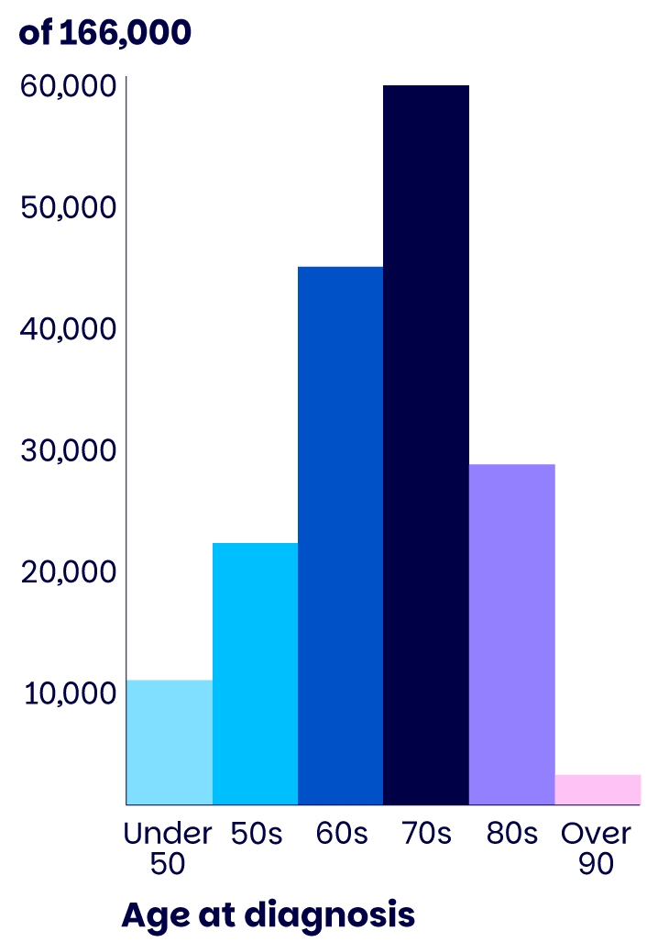
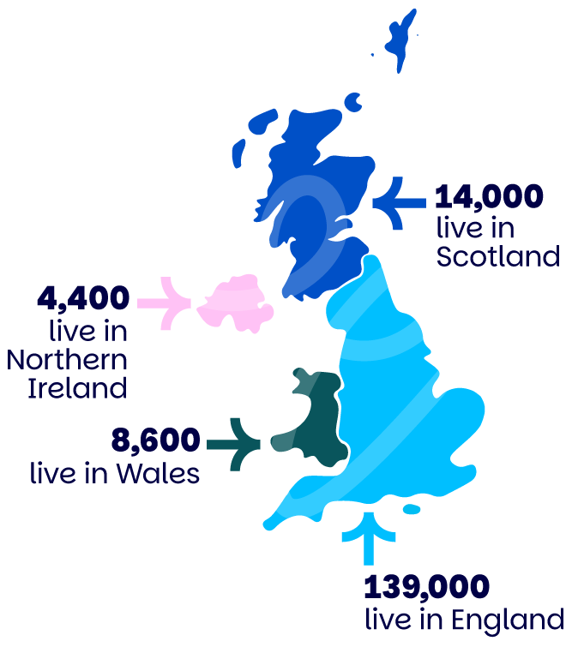
Parkinson’s Aetiology and Epidemiology
PD is a multifactorial disease, with both genetic and environmental factors playing a role.
Age is the biggest risk factor for PD, with the median age of onset being 60 years of age.
The incidence of the disease rises with age to 93.1 (per 100,000 person-years) in age groups between 70 and 79 years.
Female: Male
1: 1.5
Notes:
Additionally, there are cross-cultural variations, with higher prevalence reported in Europe, North America, and South America compared with African, Asian and Arabic countries (1).
Parkinson's disease (PD) affects men at a higher rate than women, with an incidence about 1.5 times higher,
Parkinson's is on the rise. By 2030, we expect the number of people with Parkinson’s in the UK to reach 173,000, as the population grows and ages.
We think

Slide 34
Pathophysiology
• Loss of dopaminergic neurons in the substantia nigra pars compacta.
• ↓ Dopamine → imbalance between dopaminergic (inhibitory) and cholinergic (excitatory) activity.
• Formation of Lewy bodies (α-synuclein aggregates).
• Leads to disordered motor control and reduced initiation of movement.
2-Minute Neuroscience: Basal Ganglia
Understanding Parkinson's Disease (Including Direct and Indirect Pathways)
Notes:
2-Minute Neuroscience: Basal Ganglia
Understanding Parkinson's Disease (Including Direct and Indirect Pathways)

Slide 35
Disease Progression
Mild, unilateral
Bilateral, no balance issue
Postural instability
. Severe disability
Wheelchair/bed-bound
• Insidious onset, progressing over years to decades.
• Unilateral → bilateral symptoms.
• Hoehn & Yahr stages:

Slide 36
Hallmark Clinical Features
Additional Motor Symptoms
Reduced arm swing, shuffling gait, freezing
Hypomimia (masked face)
Dysarthria, hypophonia
Micrographia (small handwriting).
Reduced Dexterity
Fatigue
Cardinal signs:
• Bradykinesia – slowness of movement
• Rigidity – increased tone (lead-pipe or cogwheel)
• Resting tremor – 'pill-rolling' type
• Postural instability – impaired balance, increased falls risk.
Festination and Freezing
Notes:
key diagnostic signs in medicine
Sensory:
• True sensory loss uncommon
• Altered proprioception, musculoskeletal pain.
Typical early symptoms which you might notice include:
a reduced sense of smell
depression
anxiety
tiredness
problems with sleep
constipation

Slide 37
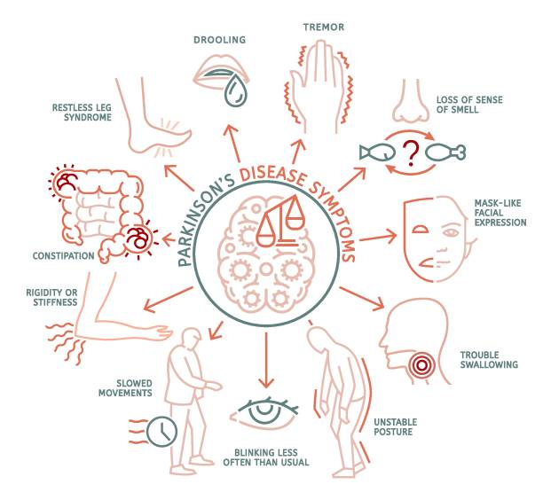
Non-Motor Features
• Autonomic dysfunction: constipation, orthostatic hypotension
• Neuropsychiatric: depression, anxiety, hallucinations
• Sleep disturbance, REM sleep behaviour disorder
• Cognitive decline in later stages (Dementia)
• Sensory symptoms: pain, anosmia.

Slide 38
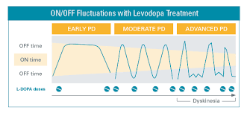
“On” and “Off”
Notes:
Parkinson’s is caused by loss of dopamine-producing neurons in the substantia nigra, leading to disrupted control of movement.
Levodopa (and other dopaminergic drugs) temporarily restore dopamine levels, improving movement (“ON” phase).
Why ON/OFF Fluctuations Occur:
Disease progression: fewer surviving neurons to store and release dopamine → brain relies directly on medication levels.
Levodopa’s short half-life (~90 min): blood levels rise and fall rapidly → fluctuating dopamine availability.
Reduced buffering capacity: loss of neuronal terminals means the brain can’t smooth out dopamine peaks/troughs.
Receptor and enzyme changes: long-term levodopa use alters dopamine receptor sensitivity and metabolism.
Dietary or absorption factors: protein-rich meals and delayed gastric emptying can reduce levodopa absorption → sudden “OFF.”
Clinical result:
“ON” period: medication working → smooth, mobile movement.
“OFF” period: drug effect wears off → tremor, rigidity, bradykinesia return suddenly.
Physiotherapy relevance:
Schedule therapy sessions during predictable ON phases for best mobility and participation.
Educate patients to track fluctuations and coordinate with the MDT for medication review.

Slide 39
PD
Parkinson's Disease Freezing & Festinating Gait
2-Minute Neuroscience: Parkinson's Disease
Notes:
Parkinson’s is caused by loss of dopamine-producing neurons in the substantia nigra, leading to disrupted control of movement.
Levodopa (and other dopaminergic drugs) temporarily restore dopamine levels, improving movement (“ON” phase).
Why ON/OFF Fluctuations Occur:
Disease progression: fewer surviving neurons to store and release dopamine → brain relies directly on medication levels.
Levodopa’s short half-life (~90 min): blood levels rise and fall rapidly → fluctuating dopamine availability.
Reduced buffering capacity: loss of neuronal terminals means the brain can’t smooth out dopamine peaks/troughs.
Receptor and enzyme changes: long-term levodopa use alters dopamine receptor sensitivity and metabolism.
Dietary or absorption factors: protein-rich meals and delayed gastric emptying can reduce levodopa absorption → sudden “OFF.”
Clinical result:
“ON” period: medication working → smooth, mobile movement.
“OFF” period: drug effect wears off → tremor, rigidity, bradykinesia return suddenly.
Physiotherapy relevance:
Schedule therapy sessions during predictable ON phases for best mobility and participation.
Educate patients to track fluctuations and coordinate with the MDT for medication review.

Slide 40
Red Flag/Urgent Referral Indicators
• Rapid deterioration or collapse during 'off' episodes
• Acute confusion or hallucinations
• Severe orthostatic hypotension
• Recurrent unexplained falls
• Sudden dysphagia or aspiration
• Atypical symptoms (early dementia, gaze palsy, pyramidal signs).
Notes:
Pyramidal signs are a set of neurological symptoms indicating damage or dysfunction in the pyramidal tract of the brain or spinal cord. They include weakness, spasticity, hyperreflexia, and the Babinski sign.

Slide 41
Physiotherapy Assessment
Prioritise:
• Movement initiation, gait pattern, posture
• Balance, tone, ROM
• Functional ability and endurance
• Respiratory function
Outcome measures:
UPDRS, TUG, 10MWT, Berg Balance Scale.
Notes:
Stiff ribcage/rigidity can affect respiration.
Unified Parkinson's Disease Rating Scale,

Slide 42
Early Stage
Mid Stage and Late Stage
Goals:
• Maintain activity and fitness
• Improve movement amplitude (LSVT BIG)
• Postural re-education
• Educate on self-management and medication timing
Interventions:
• Stretching, strengthening, gait cueing, balance exercises.
Goals:
• Prevent complications
• Maximise safety and mobility
• Support ADLs and reduce falls risk
Approaches:
• Functional task training, cueing strategies
• Assistive devices, aids, equipment and home adaptation
• Carer education and palliative support.
Notes:
LSVT BIG (Lee Silverman Voice Treatment – BIG) is an evidence-based physiotherapy programme designed to improve movement amplitude (size) in people with Parkinson’s disease.
Core Principle:
Parkinson’s causes patients to perceive their movements as normal, even when they are small or slow.
LSVT BIG retrains the brain to recognise and produce bigger, more normal movements.
Key Features:
Focus on large, exaggerated movements (“Think BIG!”)
High intensity and repetition (4 sessions/week for 4 weeks)
Task-specific practice for daily activities (walking, reaching, turning)
Combines motor learning, cueing, and amplitude calibration
Benefits:
Improves speed, balance, and gait
Enhances functional mobility and confidence
Can be integrated into home exercise and community programmes
Physiotherapy Role:
Deliver structured sessions, reinforce home practice, and adapt exercises to functional goals.
ALSO NOTE LSVT LOUD – SLT.

Slide 43
Physiotherapy Role in MDT
Collaborate with:
Neurologist, OT, SLT, Dietitian, Parkinson’s Nurse, Palliative team.
Physio priorities:
• Optimise mobility, posture, function
• Schedule therapy with 'on' medication periods
• Educate and support patients and caregivers.

Slide 44
References
• NICE Parkinson’s Disease in Adults (2024)
• Keus SH et al. European Physiotherapy Guidelines (2020)
• RCPhysiotherapy Guidelines (2022).
Homepage | Parkinson's UK
Tomlinson CL, Patel S, Meek C, Herd CP, Clarke CE, Stowe R, Shah L, Sackley C, Deane KHO, Wheatley K, Ives N. “Physiotherapy intervention in Parkinson’s disease: systematic review and meta-analysis.” BMJ. 2012;345:e5004. Ovid+2PMC+2
Song J, et al. “Effect of Physiotherapy Interventions on Motor Symptoms in People With Parkinson’s Disease: A Systematic Review and Meta-Analysis.” [Journal] (2023) — 42 RCTs, ~2,530 participants. PubMed
Mancinelli, et al. “The effectiveness of physiotherapy treatment on balance dysfunction and postural instability in persons with Parkinson’s disease: a systematic review and meta-analysis.” BMC Sports Science, Medicine & Rehabilitation. 2016;8:34. BioMed Central
“Interventions for promoting physical activity in people with newly diagnosed Parkinson’s disease: scoping review.” Gilby J., Kent B., Lozano RK et al. Systematic Reviews. 2025;14:164

Slide 45
Cerebellar Ataxia

Slide 46
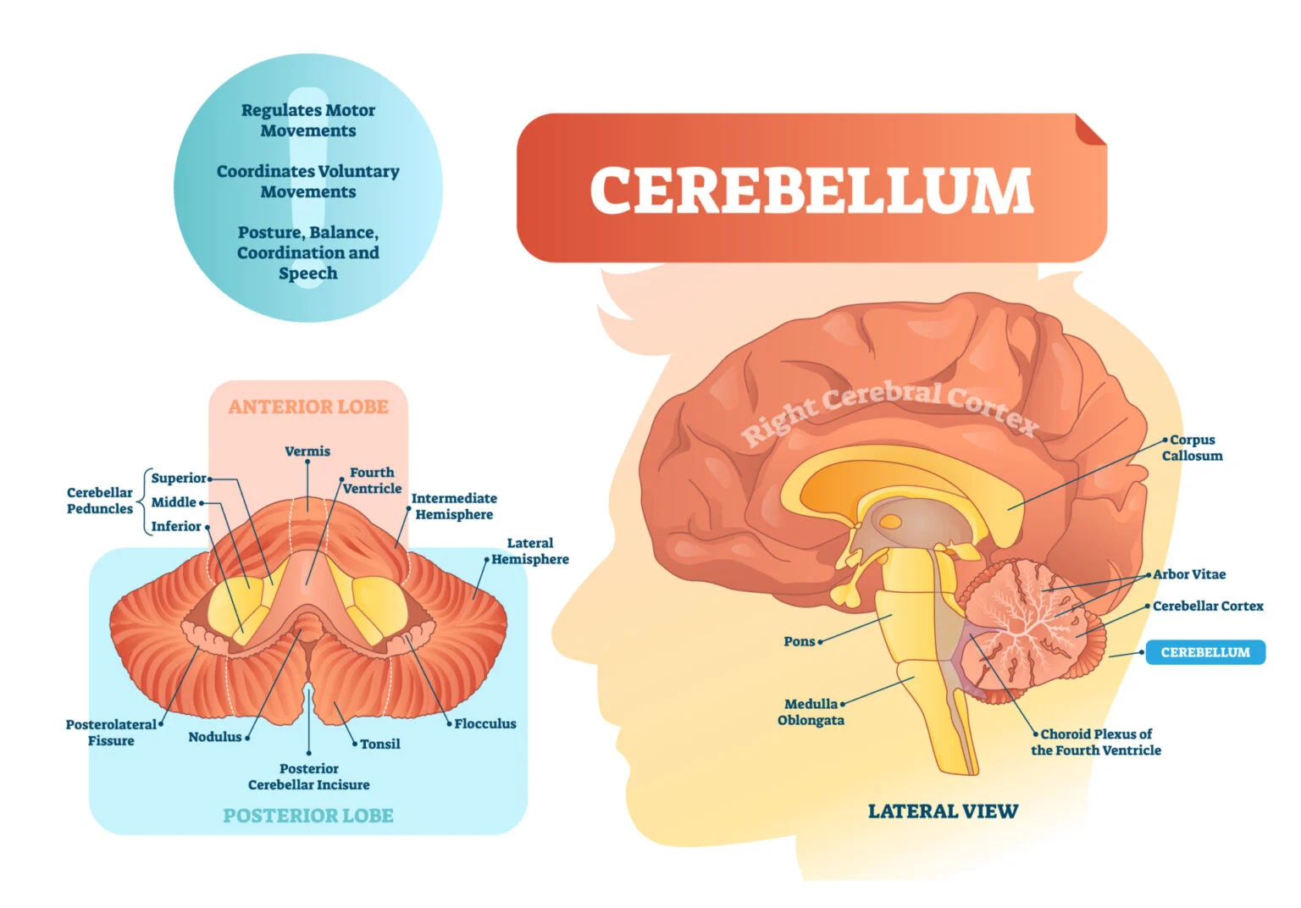
Overview of Cerebellar Ataxia
• Ataxia = incoordination of movement due to cerebellar dysfunction.
• Affects timing, accuracy, and control of movement.
• Types: congenital, acquired, degenerative.
• Common causes: stroke, multiple sclerosis, toxins, hereditary ataxias.
Notes:
• Cerebellum has three lobes: anterior, posterior, flocculonodular.
• Responsible for coordination, balance, and error correction.
• Input: spinal cord, vestibular system, cerebral cortex.
• Output: thalamus and motor cortex for movement control.
Normal Function of the Cerebellum:
Integrates sensory input (proprioception, vestibular, visual) with motor output.
Ensures smooth, coordinated, and precise movement.
Regulates muscle tone, posture, and balance.

Slide 47
CA Aetiology and Epidemiology
Cerebellar ataxia has diverse aetiologies, including genetic causes like spinocerebellar ataxias (SCAs) and Friedreich's ataxia, and acquired causes such as autoimmune disorders, toxins, trauma, stroke, and infections
Epidemiological data shows varying prevalence rates depending on the aetiology:
Prevalence of late-onset cerebellar ataxia (LOCA) to be 8.4 per 100,000 for sporadic idiopathic cases and 1.8 per 100,000 for inherited forms.

Slide 48
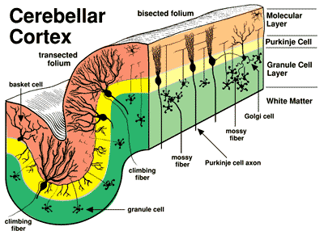
Pathophysiology
• Damage to Purkinje cells and cerebellar pathways disrupts timing of muscle activation.
• Leads to dysmetria, dysdiadochokinesia, intention tremor.
• Degenerative ataxias show neuronal loss, gliosis, and synaptic dysfunction.
• Genetic forms involve protein aggregation (e.g., spinocerebellar ataxia).
Notes:
Damage to cerebellar neurons (especially Purkinje cells) →
these cells normally inhibit over-activity and fine-tune signals to the rest of the brain.
When they die or stop functioning, movement signals become uncontrolled and poorly timed.
Communication breakdown between the cerebellum and the motor cortex or brainstem →
the body can’t properly correct movement errors.
Loss of sensory integration →
without good proprioceptive or vestibular feedback, the brain can’t sense where the limbs are in space.
Result:
Movements become inaccurate, jerky, and unsteady — this is ataxia.
protein aggregation” means
Normally, cells make proteins that fold into specific shapes so they can function properly.
In many genetic ataxias, mutations cause abnormal or misfolded proteins to be produced.
These misfolded proteins clump together (aggregate) inside neurons, particularly Purkinje cells and deep cerebellar nuclei.
Over time, these protein aggregates are toxic — they disrupt normal cell function, energy metabolism, and eventually lead to cell death.

Slide 49
Disease Progression
• Gradual onset with progressive worsening of coordination and balance.
• Rate depends on etiology – degenerative types progress slowly, acquired may stabilize.
• Non-progressive forms remain stable.
• Advanced stages lead to severe gait and truncal ataxia.

Slide 50
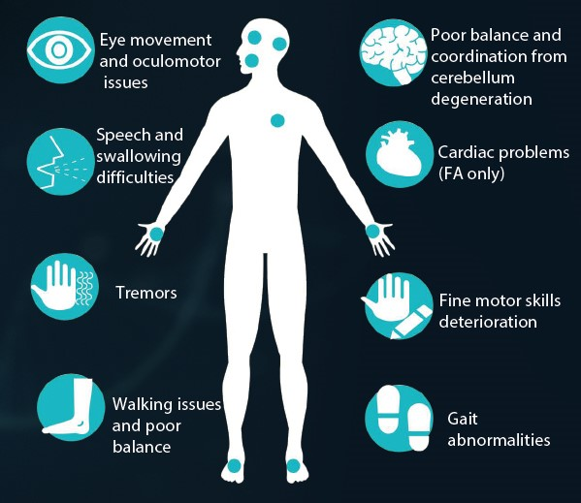
Hallmark Clinical Features
• Dysmetria – overshoot/undershoot movements.
• Dysdiadochokinesia – impaired rapid alternating movements.
• Intention tremor.
• Gait ataxia – wide-based, staggering gait.
• Hypotonia and dysarthria.
• Nystagmus and poor ocular coordination.
Ataxic Gait

Slide 51
Motor & Sensory Deficit Patterns
Motor:
• Incoordination, not weakness.
• Irregular, unsteady limb and gait movements.
• Poor timing and control.
Sensory:
• True sensory loss rare.
• If present → consider mixed pathology (sensory ataxia).
Notes:
Movements become inaccurate, delayed, and poorly coordinated.
Presents as dysmetria, intention tremor, ataxic gait, dysarthria, and nystagmus.
Muscle tone may be hypotonic due to reduced cerebellar facilitation of spinal motor neurons.

Slide 52
Red Flag/Urgent Referral Indicators
• Acute/subacute onset (stroke, tumour, demyelination).
• Rapid progression with other neurological signs.
• Raised intracranial pressure, severe headache.
• Sudden dysphagia, aspiration, or severe truncal instability.
• Fever, systemic illness, or altered consciousness.
Recurrent Falls

Slide 53
Physiotherapy Assessment
Prioritise
• Gait and posture.
• Coordination and balance (finger-nose, heel-shin, SARA, ICARS).
• Functional mobility (TUG, Berg Balance Scale).
• Trunk stability, falls risk.
• Fatigue and endurance.
Notes:
International Cooperative Ataxia Rating Scale
The ICARS was developed to quantify the level of impairment as a result of ataxia as related to hereditary ataxias.

Slide 54
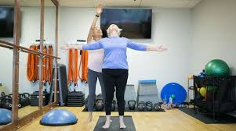
Physiotherapy Management Principles
• Coordination and balance training
• Gait re-education, cueing strategies.
• Strength and flexibility exercises.
• Fall prevention and environmental modifications.
• Education on safety and fatigue management.
Notes:
Think about vestibular priming also
Limited high-quality evidence.
• Heterogeneity of ataxia types complicates research. heterogeneity means there are many different forms or causes of ataxia — not just one single disease.

Slide 55
Early Stage
Mid Stage
Late Stage
• Use of aids, orthoses, and adaptive equipment.
• Fall prevention, task-specific training.
• Positioning, passive movement, comfort care.
• Caregiver education and transfer safety.
• Promote active movement and coordination.
• Posture and balance re-education.
Stage-Based Management

Slide 56
Physiotherapy Role in the MDT
Collaborate with:
Neurologist, Occupational Therapist, Speech Therapist, Dietitian.
Physiotherapy priorities:
– Optimise balance and function.
– Maintain mobility and independence.
– Educate on home exercises and fall prevention.

Slide 57
References
• NICE Neurological Conditions Guideline (2024).
• Ataxia UK Allied Health Guidelines (2019).
• Frontiers Neurology 2024; 15:1491142.
Ilg W., Synofzik M., Brötz D. et al. “Effects of physiotherapy on degenerative cerebellar ataxia: a systematic review and meta-analysis.” Frontiers in Neurology. 2024;15:1491142. Frontiers+2PMC+2
Schenkman M., et al. “Home Training for Cerebellar Ataxias: A Randomized Clinical Trial.” JAMA Neurology.2023;80(1):e230141. JAMA Network
Martin C.L., Tan D., Bragge P., Bialocerkowski A. “Effectiveness of physiotherapy for adults with cerebellar dysfunction: a systematic review.” Database of Abstracts of Reviews of Effects (DARE). 2009.

Slide 58
Hyperkinetic Disorders

Slide 59
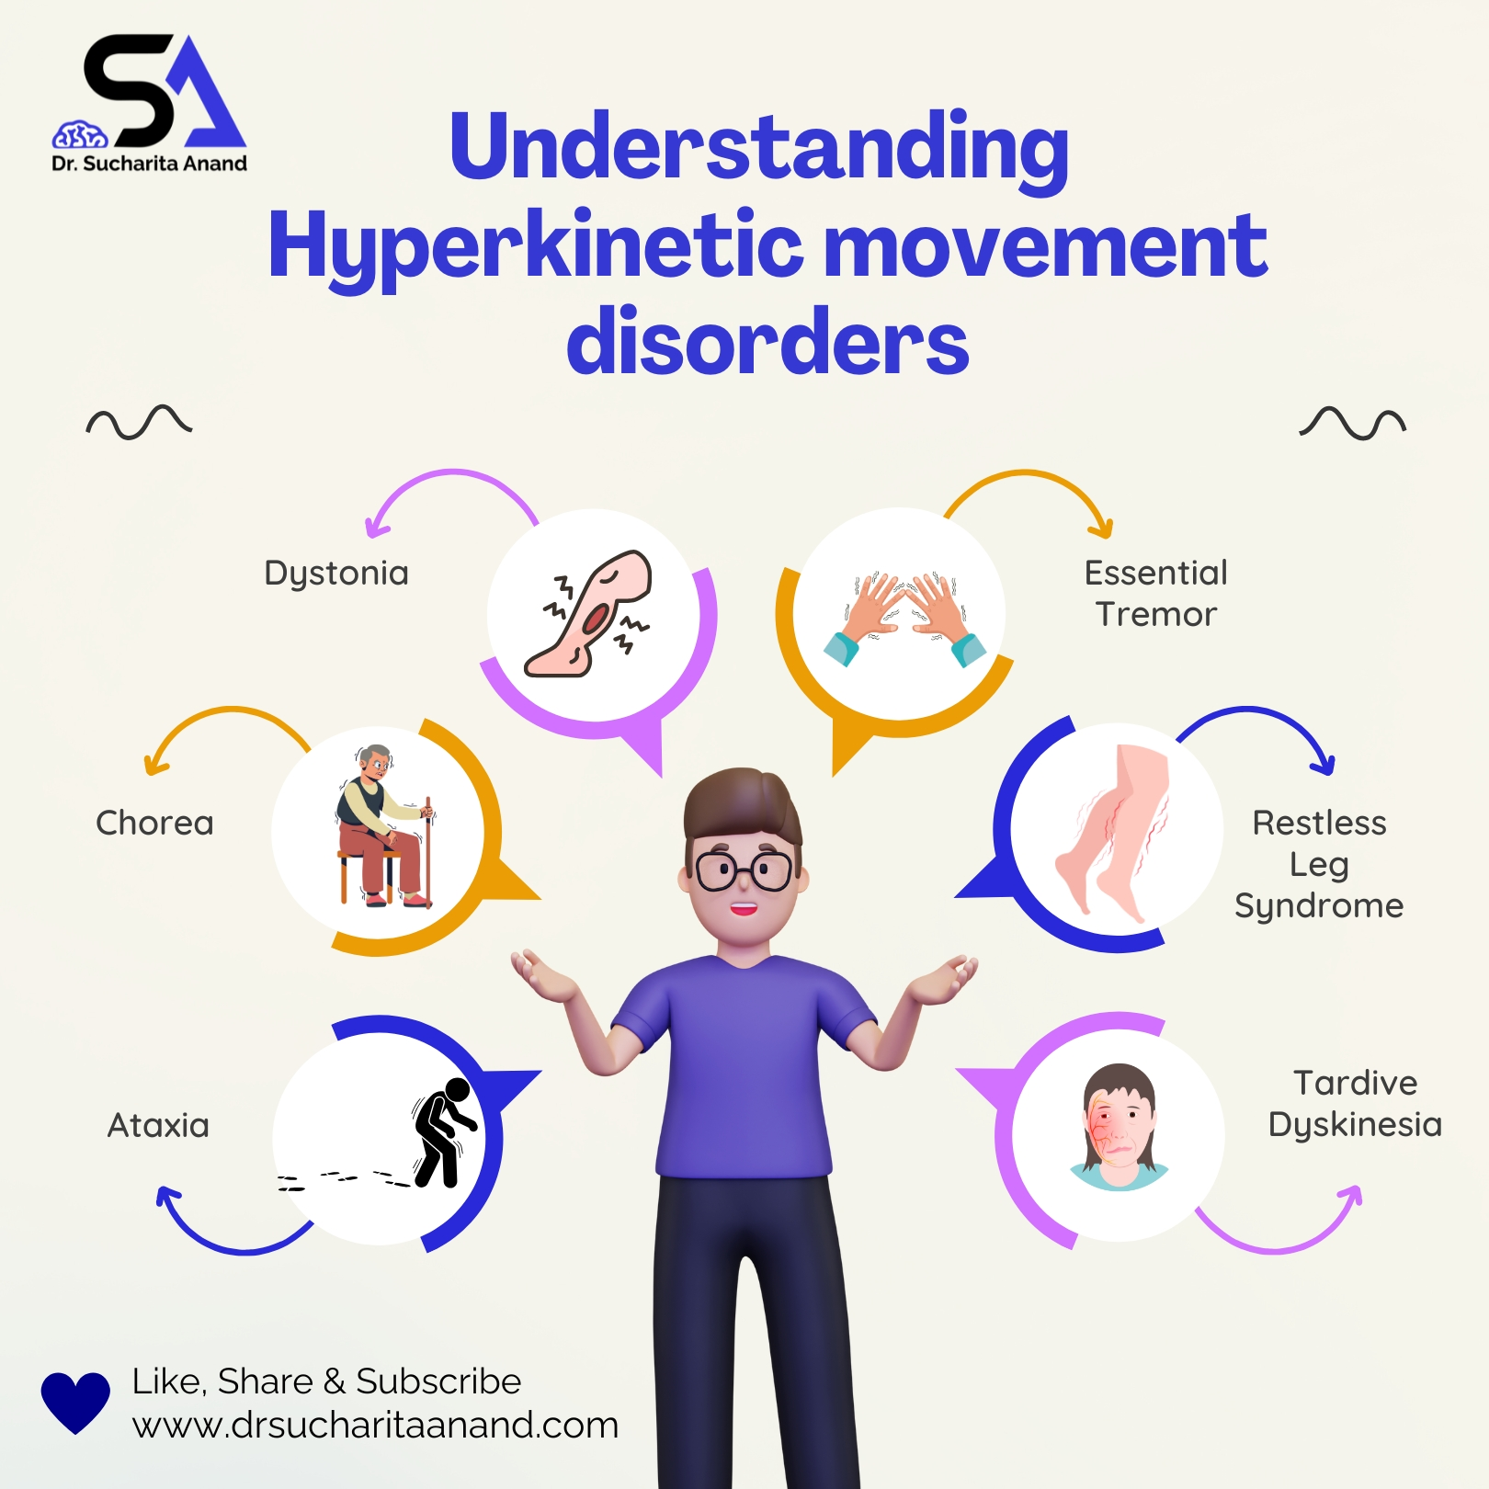
What Are Hyperkinetic Disorders?
Group of movement disorders characterised by excessive, involuntary movements
Result from basal ganglia dysfunction and altered neurotransmitter regulation (mainly dopamine, GABA, glutamate)
Examples: Huntington’s disease, Dystonia, Chorea, Tremor, Tics/Tourette’s syndrome
Notes:
Opposite of hypokinetic disorders (e.g., Parkinson’s disease)

Slide 60
Basal Ganglia Pathophysiology
Normal function: modulates motor cortex via direct (excitatory) and indirect (inhibitory) pathways
Hyperkinetic Disorders: overactivity of direct or underactivity of indirect pathway
Leads to reduced inhibition of thalamocortical neurons → excessive movement
Often involves dopaminergic overactivity

Slide 61
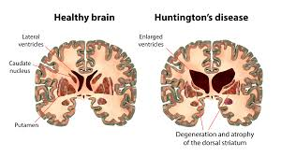
Huntington’s Disease (HD)
Genetic (autosomal dominant CAG repeat expansion on chromosome 4)
Pathophysiology: degeneration of GABAergic neurons in striatum → disinhibition of thalamus → chorea
Progression: motor → cognitive → psychiatric symptoms
Clinical features: chorea, dysarthria, dysphagia, gait instability, behavioural changes, dementia
2-Minute Neuroscience: Huntington's disease
Notes:
This neurodegenerative disorder is characterized by an expansion of the CAG- ((cytosine-adenine-guanine) trinucleotide sequence within the HTT gene on the short arm of chromosome 4. The condition is inherited in an autosomal dominant pattern, meaning only one copy of the altered gene is needed for a person to develop the disease, and each child of an affected individual has a 50% chance of inheriting it.
Early signs of Huntington’s disease may include:
clumsiness or unsteadiness while walking
mild chorea, or uncontrollable muscle movements, that can affect the arms, legs, or face
changes in mood, such as irritability, anxiety, depression, or apathy
difficulty concentrating or thinking through complicated problems
abnormal eye movements
a reduced sense of smell
Symptoms affecting movement
Huntington’s motor symptoms may include:
chorea
trouble with balance and walking
loss of coordination
smaller movements (hypokinesia)
unusually slow movements (bradykinesia)
rigidity
abnormal movements or postures due to excessive muscle contraction (dystonia)
problems with eye movements
speech problems
difficulty swallowing
Cognitive symptoms
Cognitive symptoms of Huntington’s may include:
problems in organizing, planning, or making decisions
difficulties with multitasking and complex problem solving
memory impairments
difficulty learning to do things in a new or different way
slow thinking and reaction times
In the later stages of Huntington’s, patients usually develop dementia, where cognitive problems are severe enough to cause impairments in daily functioning.
Psychiatric and behavioral symptoms
Huntington’s can cause a variety of psychiatric problems and behavior changes, including:
mood swings
anxiety
depression
apathy
personality changes
an inability to recognize one’s own symptoms
sleep disorders
irritability
aggression
impulsivity
loss of inhibitions
psychosis (hallucinations and/or delusions)

Slide 62
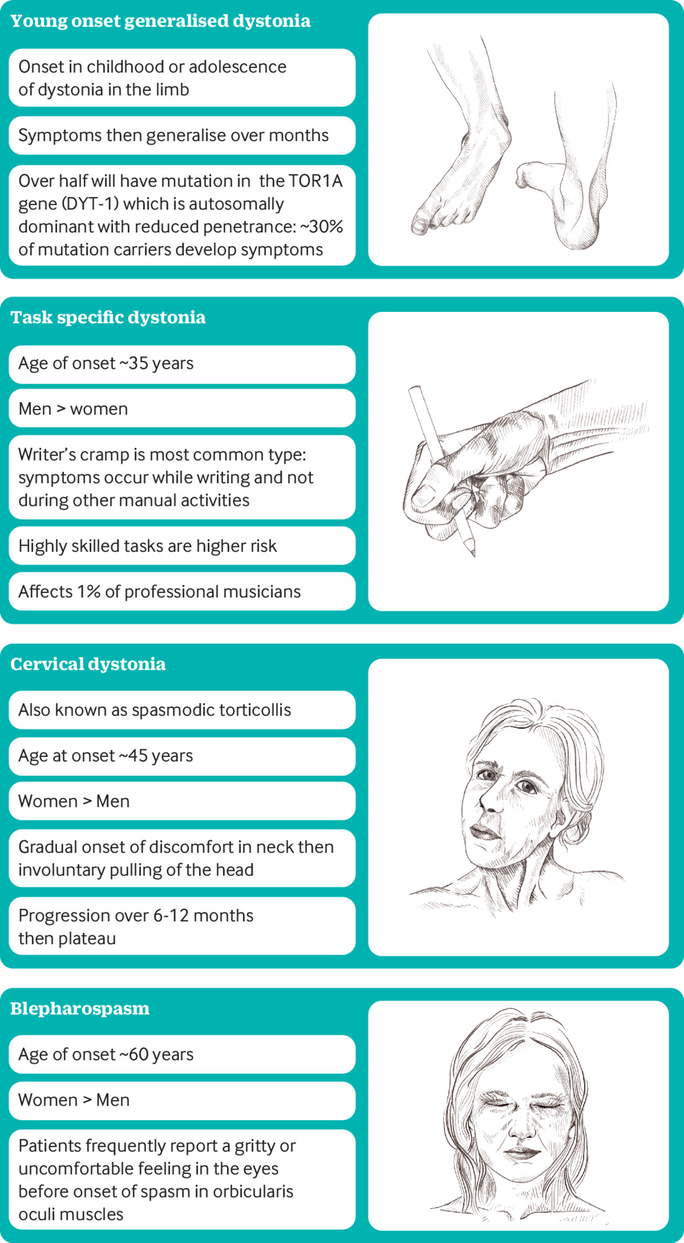
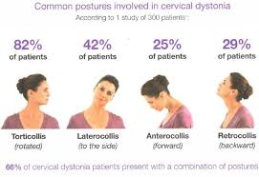
Dystonia
Sustained or intermittent muscle contractions causing twisting or abnormal postures
Pathophysiology: disordered sensorimotor integration and basal ganglia output
Can be focal (torticollis, writer’s cramp) or generalised
Clinical features: repetitive patterned movements, overflow activity, worsens with stress/fatigue

Slide 63
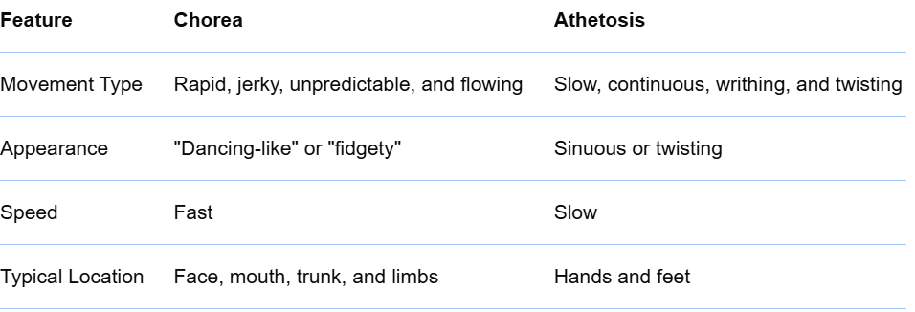
Chorea and Athetosis
Chorea
Chorea: rapid, irregular, unpredictable movements
Athetosis: slow, writhing movements (often distal limbs)
Seen in Huntington’s, Sydenham’s chorea, or metabolic causes
Sensory function often preserved; motor control and coordination impaired
Notes:
Chorea

Slide 64
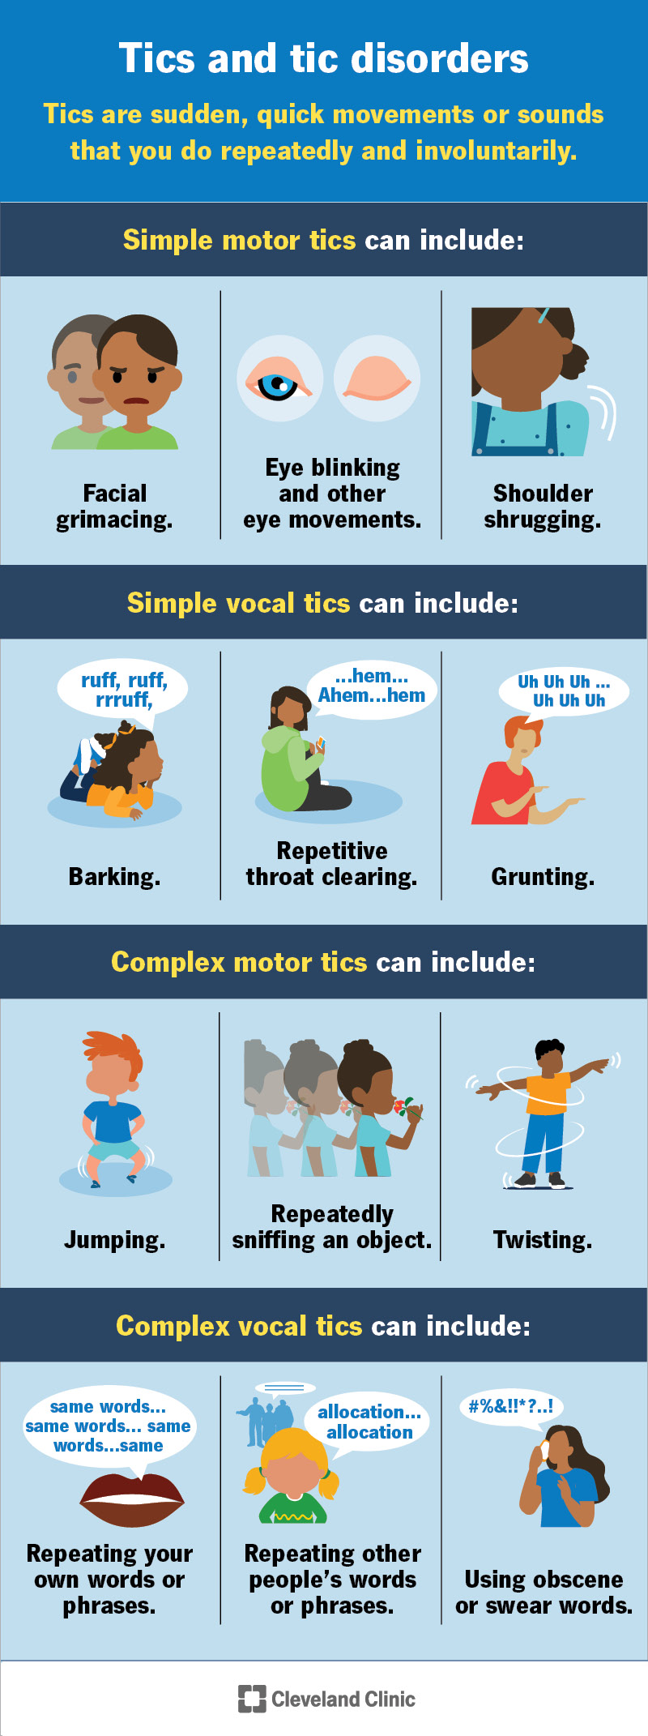
Tremor and Tics
Tremor: rhythmic oscillatory movement (e.g., essential tremor – action-related, improves with rest/alcohol)
Tics: sudden, brief, repetitive movements or vocalisations (e.g., Tourette’s)
Tics are temporarily suppressible and often preceded by a premonitory urge
Notes:
Motor tics involve body movements, like shoulder shrugging. Vocal tics involve your voice, like throat clearing. Motor tics tend to develop before vocal tics, and simple tics develop before complex tics.
Simple motor tics include:
Eye blinking, eye rolling and other eye movements.
Facial grimacing.
Shoulder shrugging.
Shoulder or head jerking.
Simple vocal tics include:
Repetitive throat clearing.
Sniffing.
Barking.
Grunting.
Complex tics are coordinated and distinct patterns of movement that involve several different muscle groups in areas throughout your body.
Complex motor tics include:
Facial grimacing combined with a shoulder shrug and a head twist.
Touching or sniffing an object.
Hopping.
Jumping.
Bending.
Twisting.
Complex vocal tics include:
Repeating your own words or phrases.
Repeating other people’s words or phrases (echolalia).
Using obscene, vulgar or swear words (coprolalia).
Before a tic occurs, you may feel an urge to perform the tic. This urge is similar to the need to scratch an itch or sneeze. A feeling of tension builds up in the affected part of your body, and giving in to the tic provides momentary relief. You may be able to postpone a tic for seconds to minutes, but you need to put in conscious effort. Typically, the urge to perform the tic ultimately becomes irresistible.
Researchers don’t know the exact cause of tics, but some scientists believe they occur due to changes in the part of your brain that controls movement. In addition, as tics can run in biological families, scientists believe the condition could also have a genetic component. Tic disorders also occur alongside other conditions, including:
Attention-deficit/hyperactivity disorder (ADHD).
Anxiety disorder.
Obsessive-compulsive disorder (OCD).

Slide 65
Common Motor and Sensory Deficit Patterns
Huntington’s: chorea, balance loss, minimal sensory deficit, cognitive decline
Dystonia: sustained contractions, task-specific, no sensory loss
Tremor: rhythmic oscillation, no sensory deficit, impairs fine motor function
Tics: sudden, brief, stereotyped movements, no sensory deficit

Slide 66
Red Flags and Urgent Referral
Acute or rapidly progressive chorea/dystonia
New-onset movement disorder with systemic symptoms (fever, confusion)
Medication-induced reactions (e.g., tardive dyskinesia, neuroleptic malignant syndrome)
Sudden gait or balance deterioration
Associated cognitive or psychiatric symptoms requiring urgent review
Notes:
Refer urgently to neurology or emergency services if acute onset; coordinate with MDT.
Tardive dyskinesia (TD) is a chronic movement disorder with involuntary facial, body, or limb movements, often caused by long-term antipsychotic medication. Neuroleptic malignant syndrome (NMS) is a rare, life-threatening reaction to antipsychotic drugs that causes a sudden and severe increase in body temperature, muscle rigidity, and changes in mental state.

Slide 67
Physiotherapy Assessment
Prioritise:
Comprehensive movement analysis: type, distribution, frequency of involuntary movements
Assess posture, balance, gait, and coordination
Functional assessment: transfers, mobility, ADLs
Outcome measures: UHDRS, Berg Balance Scale, Timed Up & Go, ROM
Screen for fatigue and falls risk
Notes:
Unified Huntington's Disease Rating Scale,UHDRS outcome measure assesses Huntington's disease (HD) through four domains: motor performance, cognitive function, behavioral abnormalities, and functional capacity

Slide 68
Physiotherapy Management Strategies
Improve function, reduce complications, promote independence through:
Task-specific motor training and postural re-education
ROM and stretching exercises
Relaxation and breathing control techniques
Gait and balance training, energy conservation strategies
Patient/carer education and environmental modification

Slide 69
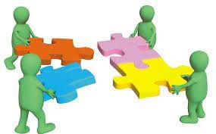
Multidisciplinary Collaboration
Neurologist: diagnosis and medication (e.g., tetrabenazine, botulinum toxin)
Occupational therapist: adaptive equipment, daily living support
Speech & language therapist: swallowing and communication support
Psychologist: behavioural and coping strategies
Social worker: community and carer support

Slide 70
References
International Parkinson and Movement Disorder Society
“Rehabilitation in movement disorders: From basic mechanisms to clinical strategies.” _ (Elsevier) 2022. PubMed
“Evidence-Based Analysis of Physical Therapy in Parkinson’s Disease with Recommendations for Practice and Research.” _ (“Movement Disorders” Vol. 22, No.
Diagnostic Evaluation of Chorea: Clinical Guide
Movement Disorders

Slide 71
Functional Neurological Disorder (FND)

Slide 72
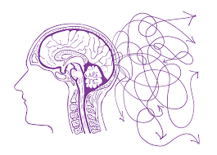
What is Functional Neurological Disorder (FND)?
FND is when there is a problem with the functioning of the nervous system and how the brain and body send and receive signals, resulting in neurological symptoms in the absence of structural neurological damage
Symptoms are real, reflecting altered brain network activity
Results from a functional disconnection rather than tissue injury

Slide 73
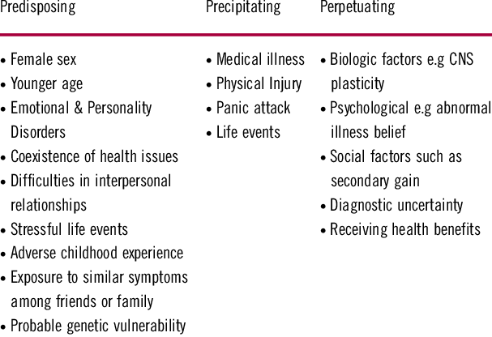
Aetiology and Risk Factors
Notes:
While precise numbers vary, FND is considered common. For example, some estimates suggest there are at least 50,000–100,000 people with FND in the UK.
More research.
Functional Neurological Disorder (FND) is common, affecting about 1 in 100 to 1 in 200 people, and accounts for roughly 6% of neurology outpatient appointments. It is one of the most frequent reasons for seeing a neurologist, and estimates suggest there are tens of thousands of people affected in the UK alone. However, the condition is often underestimated due to underdiagnosis and miscoding in medical record
Often referred to as the most common condition you have never heard of.

Slide 74
Pathophysiology Overview
Brain networks involved: motor cortex, limbic system, insula, prefrontal cortex
Abnormal activation/inhibition disrupts voluntary control
Mismatch between intention and movement execution ('software, not hardware')
Triggers include stress, trauma, pain, or illness
fMRI studies show altered connectivity and network dysfunction
Notes:
Show a diagram of brain network dysfunction for illustration.

Slide 75
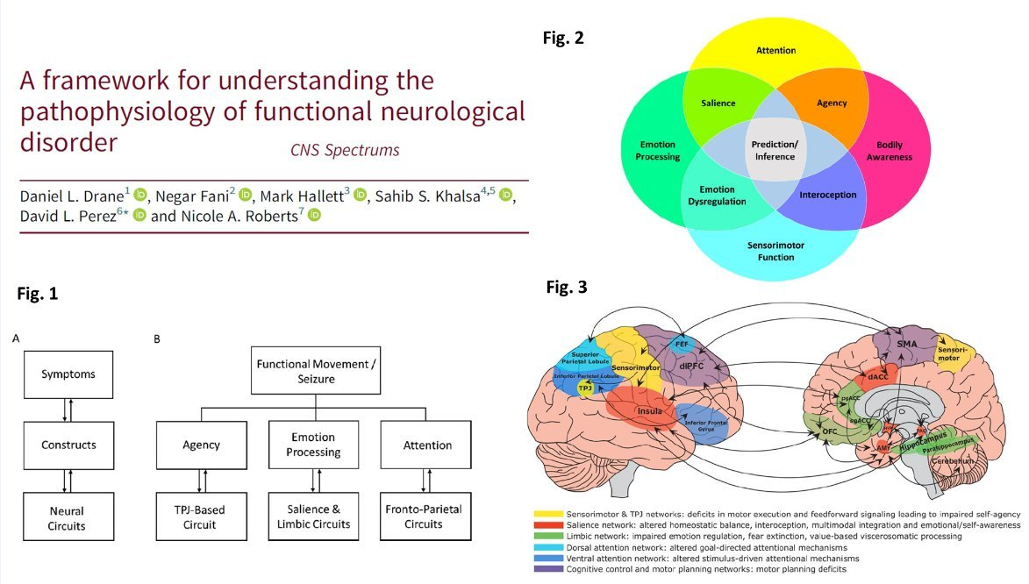
Pathophysiology
Notes:
Recent research out of Cambridge university. Fig 1. A) Illustration of the relationship between symptoms, constructs and neural circuits underlying functional neurological disorder (FND). Symptoms can be understood as mapping onto alterations of different constructs, which are generated by neural circuit abnormalities. B) Examples of how different symptoms or observable manifestations of FND can be understood as arising from one or a combination of specific abnormal constructs. For example, paroxysmal movements can be perceived as involuntary by an individual with FND due to a dysfunction of the construct of agency, which is driven by abnormalities of a TPJ-based circuit. TPJ indicates temporo-parietal junction. Fig 2. Abnormalities of several constructs (and their associated neural circuits) can interact in different ways to produce symptoms and observable signs of functional neurological disorder. Fig 3. Display of brain circuits (and related constructs) that are emerging
A neural construct refers to a functional brain process or network of neural activity that underlies a particular symptom, experience, or behaviour.
It is not a single structure, but a dynamic interaction of brain regions that together produce a certain function (e.g. movement, attention, emotion).
e.g. Example: Parkinson’s Disease
Neural circuit: Basal ganglia–thalamocortical loop.
Neural construct: Regulation of movement amplitude and automaticity.
Symptom: Bradykinesia (slowness of movement) when that construct fails.

Slide 76
Clinical Features: Motor Presentations
Functional Weakness/Paralysis – inconsistent with neuroanatomy, variable over time
Hoover’s sign or hip abductor test may be positive
Functional Tremor – variable, distractible, entrainable, improves with distraction
Functional Gait Disorder – 'walking on ice', dragging leg, knee buckling, exaggerated sway
Motor: variable weakness, tremor, abnormal gait, fixed dystonia
Coordination: jerky, inconsistent, improves with distraction

Slide 77
Clinical Features: Sensory and Seizure Presentations
Functional Sensory Loss – non-dermatomal pattern, fluctuates, sharp midline cut-off
Functional Non-Epileptic Attacks (FNEA) – resemble epilepsy but no EEG change
FNEA often longer, eyes closed, fluctuating course, responsive to reassurance
Notes:
In organic sensory loss, there is a slight overlap of nerves at the midline (1-2 cm), but FND can show an exact, sharp split, which is considered a functional sign. This type of sensory split, often described as a "hemisensory syndrome," is a key diagnostic indicator for FND.
Functional (Non-Epileptic) Attacks
Sensory: loss or paraesthesia in non-dermatomal areas, fluctuating location

Slide 78
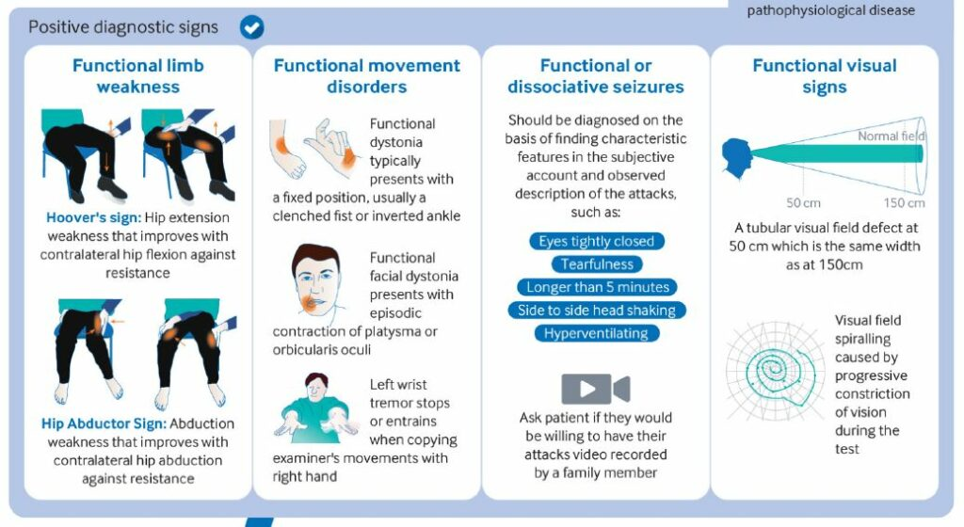
Distinguishing Features & Diagnostic Clues
Positive signs confirm FND rather than exclusion of disease
Hoover’s sign: strength returns with contralateral effort
Tremor changes with distraction or entrainment
Gait improves with dual-tasking
Sensory loss not matching dermatomes or myotome
Speech: stuttering, whispering, inconsistent dysphonia
Notes:
Positive signs confirm FND rather than exclusion of disease
Hoover’s sign: strength returns with contralateral effort
Tremor changes with distraction or entrainment
Gait improves with dual-tasking
Sensory loss not matching dermatomes or

Slide 79
Red Flags and Urgent Referral
Rapidly progressive weakness or paralysis
Sphincter disturbance or sensory level
Persistent altered consciousness or seizure activity
New severe headache or vision loss
Signs of infection, metabolic or vascular cause
Severe mood disruption
Notes:
Immediate neurology or acute medical referral if red flags present.
include fever, signs of systemic inflammation, laboratory abnormalities, or specific neurological findings that suggest a structural or progressive neurological disease rather than a functional one. In contrast, FND symptoms, which are genuine, are often characterized by inconsistent signs, such as weakness that fluctuates or varies with distraction, and signs that do not fit typical neurological pathways, like sensory deficits with indistinct boundaries.

Slide 80
Physiotherapy Assessment
Prioritise:
Build therapeutic alliance – validate symptoms, avoid suggesting 'it's in your head'
Focus on function and performance rather than impairment alone
Observe variability, distractibility, inconsistency in movement
Identify triggers, maintaining factors (fatigue, anxiety, fear)
Outcome measures: FMD Rating Scale, Berg Balance Scale, 10m Walk Test
Use of video feedback
Notes:
Functional Movement Disorders (FMD), most commonly the Simplified Functional Movement Disorders Rating Scale (S-FMDRS). This scale rates the severity of motor dysfunction in different body regions (face, limbs, trunk, etc.), plus gait and speech issues, by scoring both the severity and duration of symptoms. The scores are then added to provide a total score, used to evaluate and track symptom changes over time or after treatment.

Slide 81
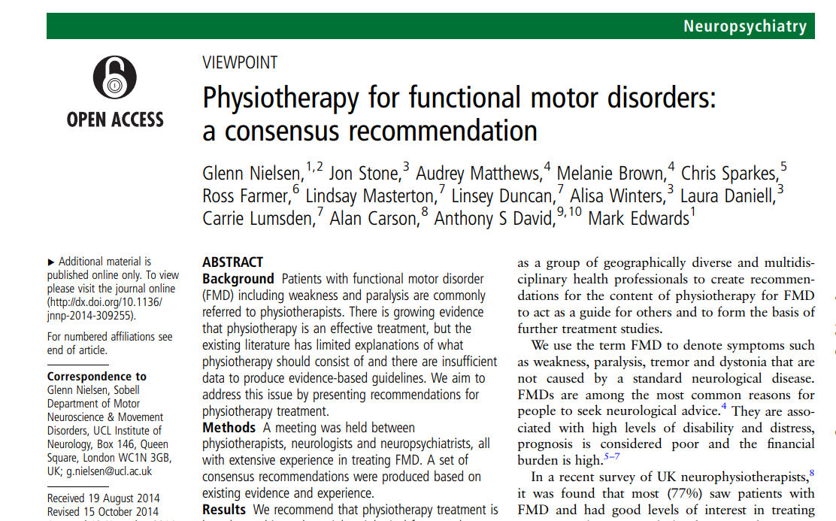
Physiotherapy Management Strategies
Key Aims:
Restore confidence and normal movement patterns
Educate using 'software vs hardware' analogy
Encourage automatic movement through graded activity
Use distraction and dual-tasking to promote normal motor control
Re-educate gait, balance, posture; manage fatigue and stress
Provide positive reinforcement and feedback
Person specific treatment – interests, hobbies, passions – could be as simple as using their favourite music!
untitled
Notes:
More research is required

Slide 82
Multidisciplinary and Psychosocial Approach
Neurologist: diagnosis and medical reassurance
Physiotherapist: movement retraining, education
Psychologist: CBT, trauma therapy, stress management
Occupational Therapist: activity planning, pacing, ADLs
Speech & Language Therapist: voice and swallowing therapy
Social and vocational support to promote reintegration

Slide 83
References
Nielsen G, Stone J, Matthews A, et alPhysiotherapy for functional motor disorders: a consensus recommendationJournal of Neurology, Neurosurgery & Psychiatry 2015;86:1113-1119.
Edwards, M. J., & Bhatia, K. P. (2012). Functional (psychogenic) movement disorders: Merging mind and brain. The Lancet Neurology, 11(3), 250–260.
Stone, J., & Carson, A. (2020). Functional Neurological Disorder: The Bare Essentials. Practical Neurology, 20(1), 13–21.
Nicholson, T. R., Aybek, S., Craig, T., Harris, T., Wojcik, W., David, A. S., & Edwards, M. J. (2020). Functional neurological disorder: A common and treatable cause of neurological symptoms. Journal of Neurology, 267(7), 1989–1999
Espay, A. J., et al. (2018). Current Concepts in Diagnosis and Treatment of Functional Neurological Disorders. JAMA Neurology, 75(9), 1132–1141.
American Psychiatric Association. (2022). Diagnostic and Statistical Manual of Mental Disorders (5th ed., Text Revision; DSM-5-TR). Washington, DC: APA Press.
Better understanding Functional Neurological Disorder and how therapy can help - Aevum Health
FND Action - Home
FND Hope - FND Hope International
Functional neurological disorder | Health topics A to Z | CKS | NICE

Slide 84
Stroke (CVA)

Slide 85
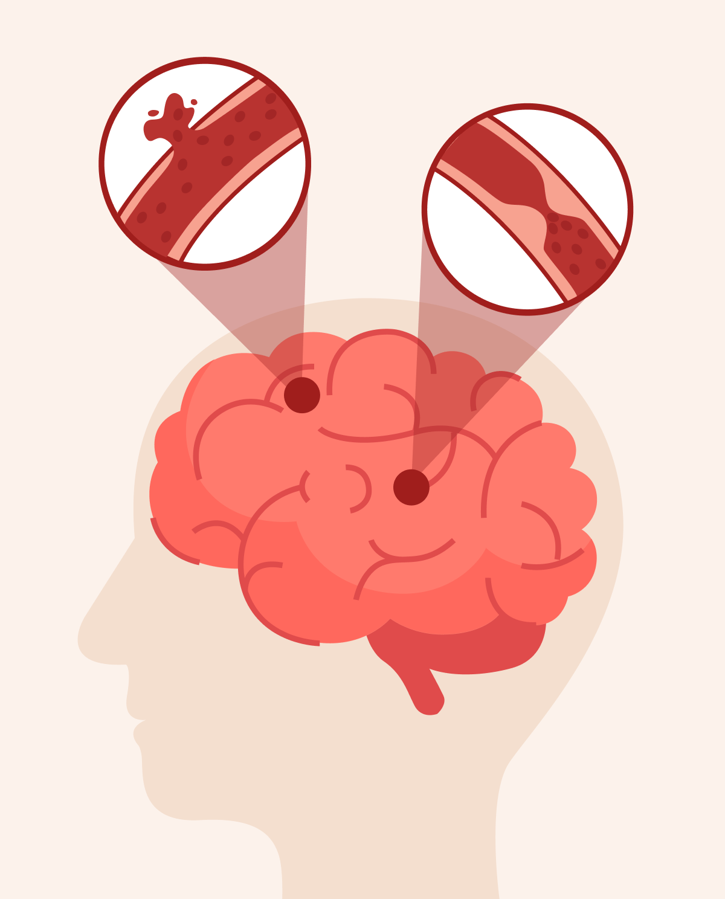
Stroke
Sudden onset neurological deficit due to interruption of cerebral blood flow
Two main types: Ischaemic (≈85%) and Haemorrhagic (≈15%)
Leads to cell death and loss of function in affected brain region
Medical emergency requiring rapid diagnosis and treatment

Slide 86
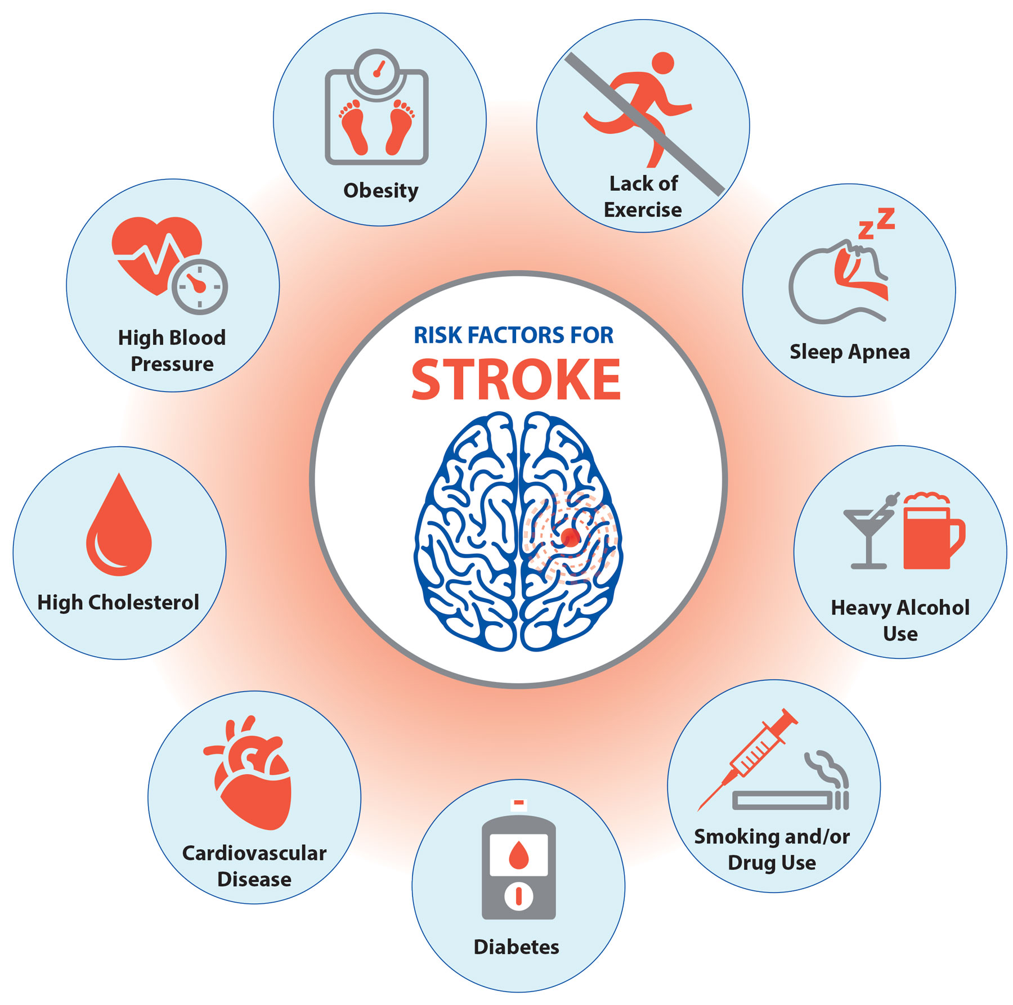
Epidemiology
100,000 people in the UK have a stroke each year (≈1 every 5 minutes).
Around 1.3 million stroke survivors living in the UK.
Third most common cause of death and leading cause of adult disability.
~75% occur in people aged over 65, but can occur at any age.
Notes:
Stroke Association (2023). State of the Nation: Stroke Statistics.
Public Health England (2022). Stroke statistics update.
NICE (2023). Stroke and transient ischaemic attack in over 16s (NG128)

Slide 87
Pathophysiology: Ischaemic Stroke
Arterial occlusion → ↓ oxygen and glucose supply
Energy failure → neuronal depolarisation and excitotoxicity (glutamate release)
Calcium influx → cell death and oxidative stress
Ischaemic core (irreversible) and penumbra (salvageable with reperfusion)
Notes:
Emphasise the concept of the penumbra and the goal of early reperfusion therapy.
The pathophysiology of an ischemic stroke begins with a sudden loss of blood flow to a part of the brain, leading to oxygen and nutrient deprivation. This energy failure causes an immediate cascade of events, including ionic imbalances, excitotoxicity from glutamate buildup, and a rapid influx of calcium into neurons. This results in oxidative stress, inflammation, and ultimately, cell death in the central "core" region of the brain. The surrounding area of partially damaged tissue, known as the "penumbra," is at risk and can be salvaged by restoring blood flow.

Slide 88
Pathophysiology: Haemorrhagic Stroke
Rupture of blood vessel causing bleeding into brain tissue or subarachnoid space
Causes: hypertension, aneurysm, AV malformation, anticoagulation
Mass effect and raised ICP lead to further injury
Blood breakdown products cause inflammation and toxicity
Often more severe acute presentation
Notes:
Hemorrhagic stroke pathophysiology involves a blood vessel rupturing and bleeding into the brain, causing two primary effects: damage from the blood itself and the pressure it exerts. The leaked blood can form a hematoma, compressing and damaging surrounding brain tissue. It also prevents oxygen and nutrients from reaching the affected areas, leading to the death of brain cells and a loss of function in the part of the body controlled by that brain region

Slide 89
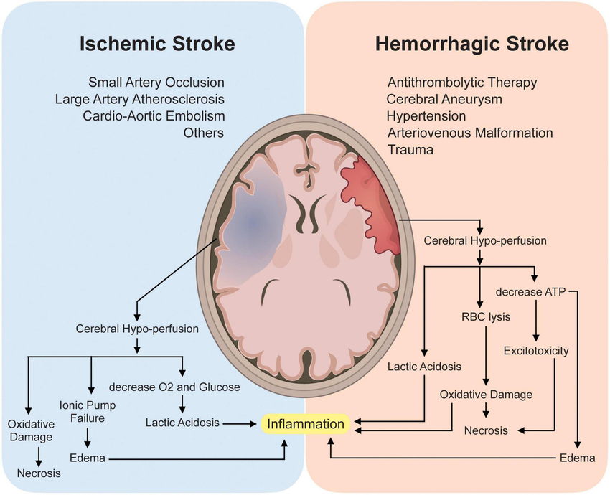

Slide 90
Progression and Recovery
Acute phase (hours–days): evolving deficits, cerebral oedema
Subacute (weeks): spontaneous recovery, neuroplasticity begins
Chronic (months–years): adaptation and compensation
Rehabilitation promotes neuroplasticity through repetition and task-specific training

Slide 91
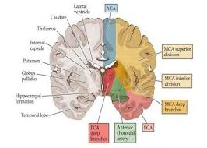
Hallmark Clinical Features
Symptoms depend on vascular territory affected
MCA: face/arm weakness, aphasia or neglect
ACA: leg weakness, abulia, urinary incontinence
PCA: visual field loss, agnosia
Brainstem: cranial nerve palsies, ataxia, dysphagia, 'locked-in' syndrome

Slide 92
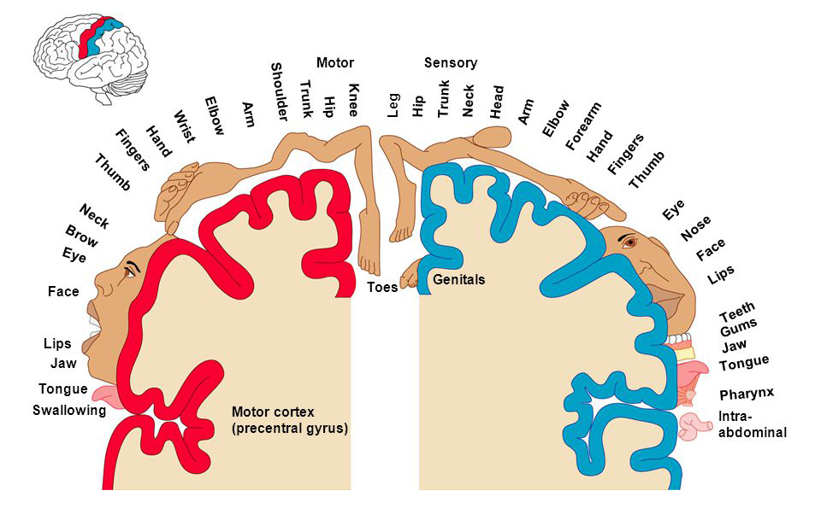
Common Motor Deficits
Hemiparesis or hemiplegia contralateral to lesion
Abnormal tone: flaccidity → spasticity → synergy patterns
Loss of selective motor control and coordination
Impaired postural control and balance
Apraxia and fatigue limiting functional performance

Slide 93
Common Sensory and Perceptual Deficits
Hemianaesthesia (contralateral sensory loss)
Proprioceptive loss impairing balance and movement accuracy
Visual field loss (homonymous hemianopia)
Neglect, especially with right parietal lesions
Dysphasia/dysarthria and cognitive impairment (attention, memory)

Slide 94
Red Flags and Urgent Referral
Sudden weakness, numbness, or visual disturbance
Difficulty speaking or understanding speech
Severe headache with vomiting or reduced consciousness
Facial droop or asymmetry
Sudden dizziness, loss of balance, or fall
FAST (Face–Arm–Speech–Time): call 999 immediately
Change in symptoms – worsening of already present stroke impairments
Notes:
Reinforce urgency of activating emergency stroke protocols.

Slide 95
Physiotherapy Assessment
Priorities:
Acute phase: vital signs, consciousness, tone, reflexes, cognition - orientation
Early mobilisation when stable to prevent complications
Neuro assessment – ROM, Sensation, Strength, co-ordination, proprioception, vision
Assess mobility, balance, strength, and functional ability
Outcome measures: FIM/FAM, Berg Balance, Modified Ashworth Scale

Slide 96
Acute Mx
Rehabilitation Mx
Task-specific and repetitive training to promote neuroplasticity
Trunk rehabilitation
Ongoing Tone management
Constraint-Induced Movement Therapy (CIMT) for upper limb
Gait retraining with symmetry, balance, and endurance focus
Functional Electrical Stimulation (FES) for foot drop, Orthotics
Education on fatigue, secondary prevention, and home exercise
Early positioning and movement to prevent complications
Maintain joint range, manage tone, and prevent oedema
Facilitate active movement on affected side (neurofacilitation)
Educate patient and carers on positioning and recovery expectations
Coordinate with MDT: nurses, OTs, SLTs, doctors
The 2023 NICE guideline (NG236) for stroke rehabilitation recommends that adults should be offered at least three hours of needs-based, multidisciplinary therapy on at least five days of the week. This increased intensity is a significant update from the 2013 guideline and is based on evidence that more intensive rehabilitation leads to better outcomes.
.
Notes:
According to NICE guidelines, repetitive task training (RTT) is recommended as the primary approach for people with upper or lower limb weakness after a stroke, regardless of cognitive impairment. This training involves frequent repetition of task-specific, functional movements both during and outside of therapy sessions to promote neuroplasticity
The 2023 NICE guideline (NG236) for stroke rehabilitation recommends that adults should be offered at least three hours of needs-based, multidisciplinary therapy on at least five days of the week. This increased intensity is a significant update from the 2013 guideline and is based on evidence that more intensive rehabilitation leads to better outcomes.

Slide 97
References
Wei X., Sun S., Zhang M. et al. “A systematic review and meta-analysis of clinical efficacy of early and late rehabilitation interventions for ischemic stroke.” BMC Neurology. 2024;24:91. BioMed Central
Abdullahi A., Wong T.W.L., Ng S.S.M. “Effects of home-based neurostimulation on outcomes after stroke: a systematic review and meta-analysis.” Neurological Sciences. 2024;45:5157-5179. SpringerLink
Khan A., Imam Y.Z., Muneer M. et al. “Virtual reality in stroke recovery: a meta-review of systematic reviews.” Bioelectronic Medicine. 2024;10:23. BioMed Central
National Institute for Health and Care Excellence (NICE). “Stroke rehabilitation in adults – Guideline NG236.” Published October 2023. nice.org.uk
Overview | Stroke rehabilitation in adults | Guidance | NICE
Brain & Spine Foundation
Stroke Association | Strength through support

Slide 98
Considerations for assessment in lifelong neuro conditions
Important to …
• Clarify expectations
Provide appropriate education
• achieve a concordance between the therapists and patient’s expectations
• Need to have short term goals and long-term goals
• Flexibility to modify goals in line with disease trajectory
Overall Aims:
1. Optimise performance in everyday activities and skills
2. Maximise functional ability
3. Prevent unnecessary disability and handicap
4. Improve quality of life

Slide 99
Key Physiotherapy Treatment Aims
1. Preserve, maintain and increase muscle strength
2. Promote postural stability
3. Prevent contractures
4. Maintain and encourage weight-bearing
5. Provide support to aid with motivation and continuation of
physiotherapy
6. Provide support to help maintain or increase activity levels
7. Patient education
8. Manage Fatigue
9. Provide aids necessary for living

